Slide 1

COST Unit 4
Small Sampling Theory

Slide 2
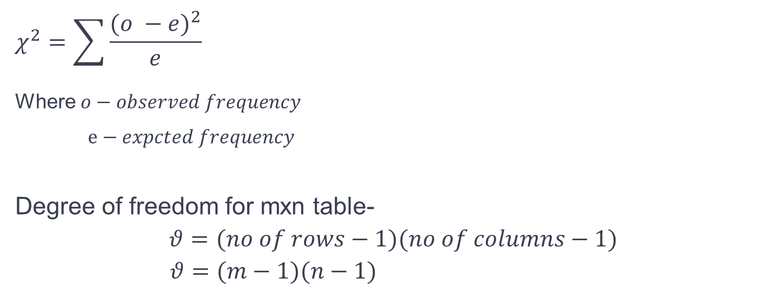
Chi square test-
A chi-square (χ²) statistic is a test that measures how expectations compare to actual observed data (or model results).
$$χ^{2}=\sum{\frac{{(o −e)}^{2}}{e}}$$
Where $o−observed frequency$
$e−expcted frequency$
Degree of freedom for mxn table-
$$θ=(no of rows−1)(no of columns−1)$$
$$θ=(m−1)(n−1)$$

Slide 3
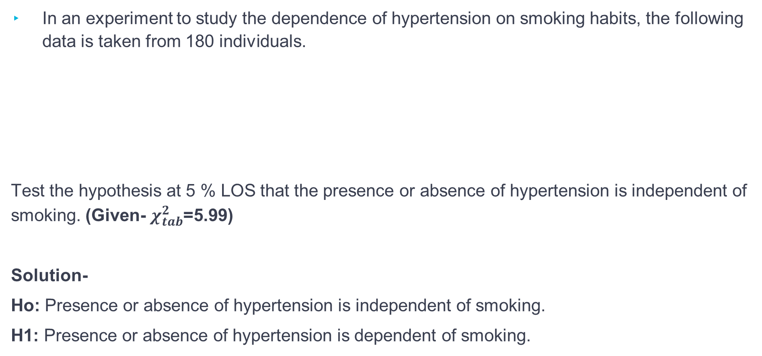
Question
In an experiment to study the dependence of hypertension on smoking habits, the following data is taken from 180 individuals.
Test the hypothesis at 5 % LOS that the presence or absence of hypertension is independent of smoking. (Given- $χ_{tab}^{2}$=5.99)
Solution-
Ho: Presence or absence of hypertension is independent of smoking.
H1: Presence or absence of hypertension is dependent of smoking.
 | No Smokers | Moderate Smokers | Heavy smokers
Hypertension | 21 | 36 | 30
No hypertension | 48 | 26 | 19

Slide 4

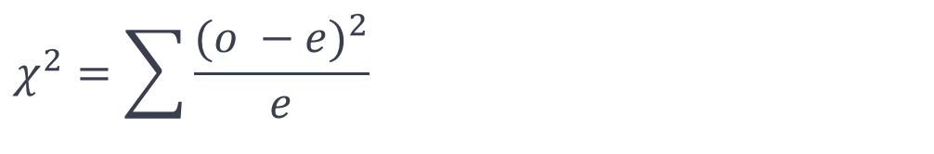
Cont.…
Formula-
$$χ^{2}=\sum{\frac{{(o −e)}^{2}}{e}}$$
Where $o−observed frequency$
$e−expcted frequency$

Slide 5
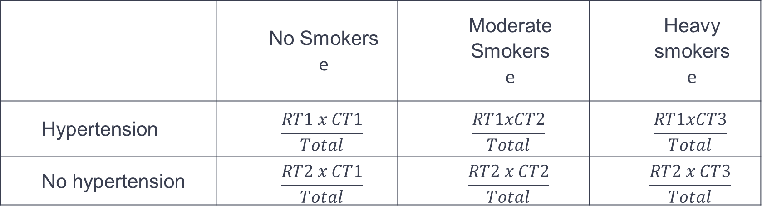
Cont. ..
 | No Smokers O | Moderate Smokers O | Heavy smokers O | Total
Hypertension | 21 | 36 | 30 | 87
No hypertension | 48 | 26 | 19 | 93
Total | 69 | 62 | 49 | 180
 | No Smokers e | Moderate Smokers e | Heavy smokers e
Hypertension | $$\frac{RT1 x CT1}{Total}$$ | $$\frac{RT1xCT2}{Total}$$ | $$\frac{RT1xCT3}{Total}$$
No hypertension | $$\frac{RT2 x CT1}{Total}$$ | $$\frac{RT2 x CT2}{Total}$$ | $$\frac{RT2 x CT3}{Total}$$

Slide 6
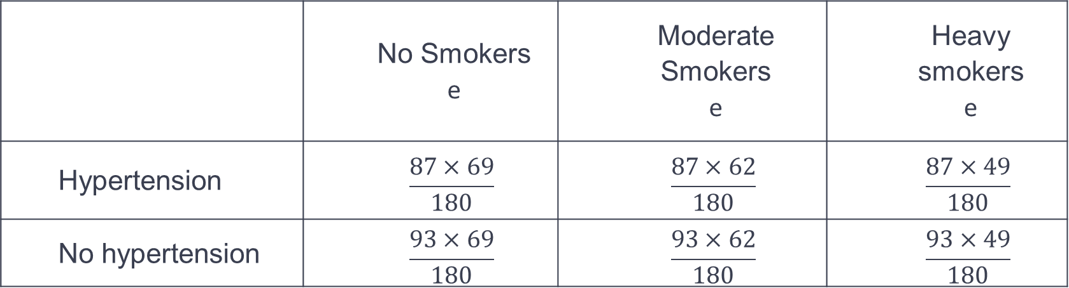
Cont. ..
 | No Smokers O | Moderate Smokers O | Heavy smokers O | Total
Hypertension | 21 | 36 | 30 | 87
No hypertension | 48 | 26 | 19 | 93
Total | 69 | 62 | 49 | 180
 | No Smokers e | Moderate Smokers e | Heavy smokers e
Hypertension | $$\frac{87×69}{180}$$ | $$\frac{87×62}{180}$$ | $$\frac{87×49}{180}$$
No hypertension | $$\frac{93×69}{180}$$ | $$\frac{93×62}{180}$$ | $$\frac{93×49}{180}$$

Slide 7
Cont. ..
o | e | $$\frac{{(o −e)}^{2}}{e}$$
21 | 33.35 | 4.5734
36 | 29.967 | 1.2177
30 | 23.683 | 1.6849
48 | 35.65 | 4.2780
26 | 32.033 | 1.1363
19 | 25.316 | 1.5761
 |  | $$χ^{2}=\sum{\frac{{(o −e)}^{2}}{e}}$$ = 14.46

Slide 8

Cont.…
$χ^{2}$=14.46
$χ_{tab}^{2}$=5.99
As $χ^{2}$> $χ_{tab}^{2}$, Reject H0 at 5% LOS.
Therefore, we cam conclude that Presence or absence of hypertension is dependent of smoking.

Slide 9
Questions- April 2019 MU
Given- $χ_{tab}^{2}$=9.49

